Slide 1
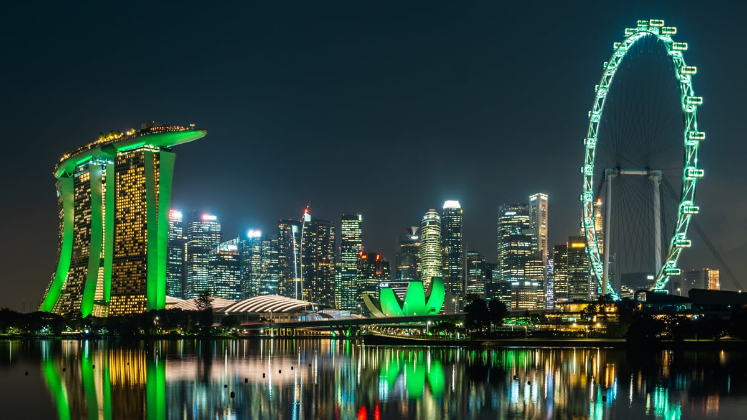

SMU Sustainable Investment Club
Directors’ Meeting 1
This presentation is strictly private and confidential. It is not to be distributed to any third party without the club’s consent
Photo Credits to The Earthshot Prize

Slide 2
Agenda for Directors’ Meeting 1
S/N | Agenda
01 | V3R
02 | Timeline
03 | Administrative Matters
04 | Workplan Matters
This part of the slide is intentionally left blank

Slide 3
Event Rundown
Event Synopsis
Sustainable Investment Summit 2024 (SIS24) is driven by a singular vision: to ignite hope and self-discovery within the sustainability community. We aim to inspire hope in youth aspiring to careers in sustainability and promote self-discovery, emphasizing that everyone has a unique role in this puzzle.
At the heart of SIS24 is the empowerment and growth of the student community. By prioritizing personal and professional development, the summit equips students with skills, knowledge, and network needed to make a successful graduate transition.
In collaboration with Singapore Green Finance Center (SGFC), SIS24 not only bridges the gap between the youth and the professional world but also connects industry leaders with the passion, curiosity, and innovation of today’s youth. By reaffirming links with SGFC’s founding partners, SIS24 renews the social commitment of the industry, inspiring the next generation.
Through these efforts, SIS24 seeks to reinforce faith in the future of sustainability. This is why SIS24 exists – to inspire and empower the leaders of tomorrow.
This part of the slide is intentionally left blank

Slide 4
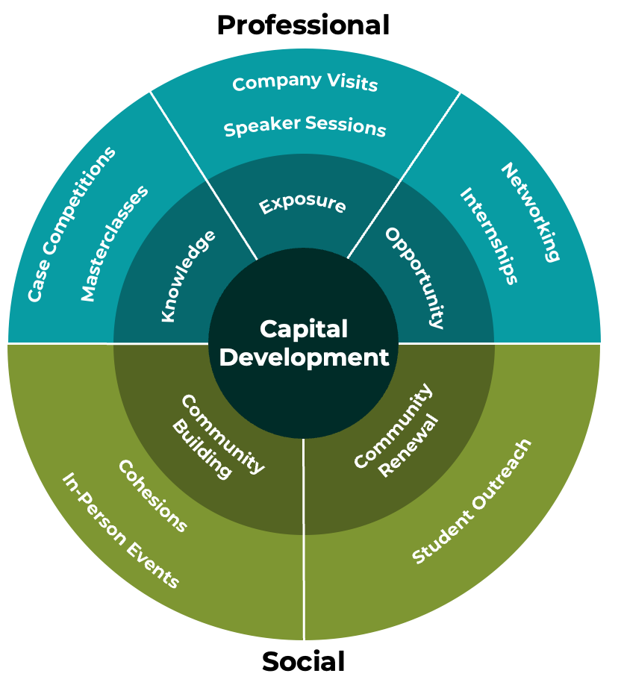
Event Rundown
Our Team
Nurturing Our People
We have recruited a 18-Member Organizing Committee, supplemented by our 13-Member ExCo.
Initiatives In-Progress
Masterclasses: Held in conjunction with SMU Pathfinders Program
Chairpersons
Speaker Sessions: BTS session on August 30th
Networking: Achieved through event planning
SI ExCo
Student Outreach: Achieved through SMU Vivace platform
Finance & Administration
External Relations
Future Work
Company Visits: Tie ups with local sustainability-focused firms for exposure
Marketing & Comms
Programs & Curriculum

Slide 5
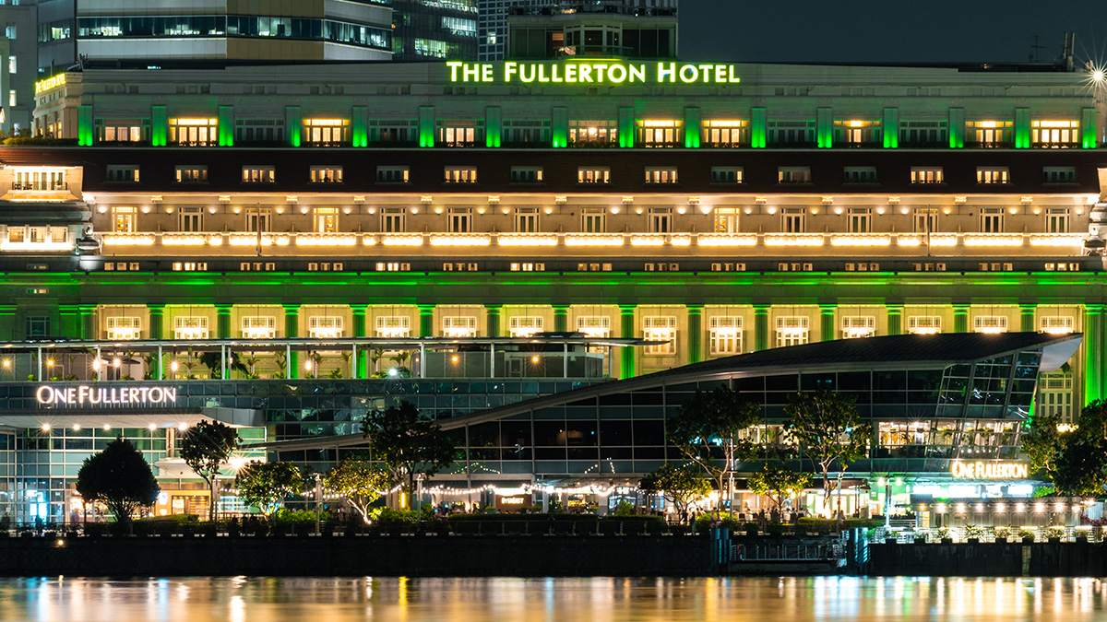
V3R
Nurturing future leaders of sustainable investing
This presentation is strictly private and confidential. It is not to be distributed to any third party without the club’s consent
Photo Credits to The Earthshot Prize

Slide 6
SIS 2024 Vision
SIS2024 Vision: To cultivate hope & self-discovery in the sustainability community
SIS2024 Mission: To empower and grow the sustainability community through opportunities in personal & professional development
S1
S2
S3
Strategic Goals
To build shared value with our strategic partners
To provide growth opportunities for the student community through a youth exposure program
To provide development opportunities for the professional community through a luminary speaker series
4 Pillars of Our Work
Core Business
B1
B2
B3
B4
Spark conversations through keynotes & panels
Connect the community through networking
Grow youth interest through academic booths
(youth series)
Facilitate graduate transition through industry booths
(youth series)
Our Members
Our Processes
M1
To deepen professional development
and personal
growth
M3
To establish trust and render strong support for every member’s wellbeing
P1
To create a culture of healthy and sustainable practices
P3
To align planning with event roadmaps for coherent end product
Organizational Excellence
M2
To conduct planning with transparency and accountability
P2
To exercise fiscal prudence and accountability in planning

Slide 7
Roles
President
Vice President
ExCo
Co-Chairs
Director
(Finance & Administration)
Director
(Marketing)
Director
(External Relations)
Director
(Programs & Curriculum)
Deputy-Director
(Finance & Administration)
-
Deputy-Director
(External Relations)
Deputy-Director
(Programs & Curriculum)
Executive
(Finance & Administration)
-
Executive
(External Relations)
Executive
(Programs & Curriculum)
SGFC
Ho Bee Land
Prof Liang Hao
LKCSB

Slide 8
Overview of Rules
Governance
Procedures
Polices
Bylaws are fundamental rule that will define our organization. Bylaws include the powers of each office, standards of behavior, etc.
Rules of order are written rules of procedures for conducting meetings in an orderly manner and the duties of each director during meetings. About procedures. Comms.
Standing rules are related to administrative details. For instance, time, date and frequency of meetings or use of discretionary funds.
General
Meetings
Conduct of Meetings
Meetings
G1 | Attire
G2 | Classroom
G3 | Drinking
G4 | Information
G6 | External
G7 | GMs
G8 | Notice
G9 | Notice
P1 | Agenda
P2 | ExCo Meetings
P3 | ExCo Meeting
P4 | Notice
P5 | General Meetings
P6 | General Meetings
PO1 | OC Meetings
PO2 | Directors’ Meetings
Use of Funds
Leave & Intern
PO4 | Overall Budget
PO5 | Event Budget
G5 | Internships
G10 | Others
P7 | Others
PO6 | Others

Slide 9
Overview of Rules: Governance
Bylaws are fundamental rule that will define our organization and will remain effective till the conclusion of the event “SIS 24”. Bylaws include the powers of each office, standards of behavior, etc.
General Standards of Behavior
S/N | Category | Rules | Rationale
G1 | Attire | Wear appropriate outfits on meeting and event days | Maintain Professional Image of SIS 24
G2 | Classroom | Be respectful to Professors and Classmates. | Maintain Professional Image of SIS 24
G3 | Drinking | Drink responsibly, especially near campus. | Maintain Professional Image of SIS 24
G4 | Information | No disclosure of information discussed in meetings outside the OC | Information Control
Personal Leave and Internships
S/N | Category | Rules | Rationale
G5 | Internships | All OC members on internships are required to attend Key Events and General Meetings. | Ensure OC member’s commitment.
This part of the slide is intentionally left blank
Consequences for breaking a governance rule: First Offence: Verbal warning to be given. Second offence: consult IIE on AP records

Slide 10
Overview of Rules: Governance
Bylaws are fundamental rule that will define our organization and will remain effective till the conclusion of the event “SIS 24”. Bylaws include the powers of each office, standards of behavior, etc.
Meetings
S/N | Category | Rules | Rationale
G6 | External | Attire for meetings with External Stakeholders (Outside SMU) should be at least Business Casual; External Stakeholders (Within SMU) should be at Smart Casual | Maintain Professional Image of SIS 24
G7 | GMs | Attire for GMs is as per school attire | Maintain Professional Image of SIS 24
G8 | Notice | Inform Co-Chair (Andrew) 3 days in advance if you are not available for a meeting | Ensure ExCo member’s commitment
G9 | Notice | Inform Co-Chair (Andrew) 30mins in advance if you are late for a meeting | Ensure ExCo member’s commitment
G10 | Others | OC members can propose new rules over the year if deemed necessary | Ensure openness in governance
This part of the slide is intentionally left blank
Consequences for breaking a governance rule: First Offence: Verbal warning to be given. Second offence: consult IIE on of disciplinary measures

Slide 11
Overview of Rules: Procedures
Rules of order are written rules of procedures for conducting meetings in an orderly manner and the duties of each director during meetings. About procedures and communication within the ExCo.
Conduct of Meetings
S/N | Category | Rules | Rationale
P1 | Agenda | Co-Chairs will decide on the agenda of meeting based on the activities of the OC and the time dedicated to each item during the meeting. | Ensure efficiency
P2 | ExCo Meetings | OC members who are accountable for the specified tasks will speak on the matter | Ensure accountability
P3 | ExCo Meeting | OC members who needs to be consulted for the specified task should be consulted during OC meetings – but subjected to the urgency of the matter | Ensure efficiency
P4 | Notice | Co-Chairs must give at least 3 days notice for any meetings. | Ensure accountability
P5 | General Meetings | All OC members are required to attend GMs. | Ensure accountability
P6 | General Meetings | Co-Chairs will chair the general meetings. In the absence of the Co-Chairs, OC can nominate another chair. | Ensure accountability
P7 | Others | OC members can propose new rules over the year if deemed necessary | Ensure openness in SOPs
NO consequences for procedural rules: Procedural rules are put in place to ensure accountability and efficiency during meetings.

Slide 12
Overview of Rules: Policies
Standing rules are related to administrative details. For instance, time, date and frequency of meetings or use of discretionary funds.
Conduct of Meetings
S/N | Category | Rules | Rationale
PO1 | OC Meetings | General Meetings will be held once a month. Date to be confirmed. | Ensure accountability
PO2 | Director’s Meetings | Directors’ Meetings will be held once a month. Date to be confirmed. | Ensure accountability
Use of Funds
S/N | Category | Rules | Rationale
PO4 | Overall Budget | Only the P, VP, Co-Chairs and Finance & Administrative Department knows the overall budget. | Information control
PO5 | Department Budget | Each department will only know their respective budget. | Information control
PO6 | Others | OC members can propose new rules over the year if deemed necessary | Ensure openness in policies
NO consequences for policy rules: Just FYI.

Slide 13
Relationships
Understanding of RACI
S/N | Action | Description
R | Responsible | The person who carries out the process or task or assignment. Responsible to get the job done.
A | Accountable | The person who is ultimately accountable for the process or the task being completed appropriately. Responsible person are accountable to this person. The person who is accountable makes the decision.
C | Consulted | People who are not directly involved with carrying out the task, but who are consulted. May be key stakeholders or subject matter experts
I | Informed | Those who are affected by the process or the tasks or who have a need to stay informed
RACI Chart Example
# | Tasks | P | VP | Co-Chair | ExCo | Director | Deputy | Exec
Pre-planning phase
03 | Planning/ Executing all operational related tasks | C | I | C | I | A | R/A | R
Oversees and Advises
Decides and Supervise
Executes
RACI Chart Serves As A Rule Of Thumb During Regular Planning, And A Guideline Under Crisis Planning

Slide 14
SIS 2024 RACI Chart
SIS24 OC RACI Chart
# | Tasks | P | VP | Co-Chair | ExCo | Director | Deputy | Exec
Pre-planning phase
01 | Develop Event strategic obj. (Roadmap, KPIs) | C | C | A | I | I | I | I
02 | Develop Department strategic obj. (Roadmap, KPIs) | I | I | C | I | R/A | R/A | I
03 | Develop Event ops. obj. (Timeline, RACI, Milestone) | C | C | A | I | I | I | I
04 | Allocation of Event Budget | C | I | A | I | R/A | R | I
Planning-phase
05 | Planning/ Executing all operational related tasks* | C | I | C | I | A | R/A | R
06 | Executing all task related to OC/ ExCo Welfare | I | I | C/A | I | R | R | I
Execution-phase/ Recovery
07 | Planning/ Executing all operational related tasks* | C | I | C | I | A | R/A | R
08 | Executing all task related to OC/ ExCo Welfare | I | I | C/A | I | R | R | I
09 | Safety | C | I | A | I | R | R | R
*All operationally related tasks consists of everything from marketing collaterals to sponsorships to event timeline, etc.

Slide 15
Timeline
Nurturing future leaders of sustainable investing
This presentation is strictly private and confidential. It is not to be distributed to any third party without the club’s consent
Photo Credits to The Earthshot Prize

Slide 16
July Agenda
Key Items
Prioritization Matrix
S/N | Item | Accountable | Responsible
1 | OC Finalization | CC | ALL
2 | Finance Onboarding | CC, D&DD(F&A) | Dept (F&A)
3 | Programs Onboarding | CC, D&DD(Progs) | Dept (Progs)
4 | Curriculum Draft | D&DD(Progs) | Dept (Progs)
5 | Speaker Deck Draft | D&DD(ER) | Dept (ER)
6 | Program Draft | D&DD(Progs) | Dept (Progs)
7 | OC Strengthsfinder Workshop | CC | CC
8 | Department Workplan | CC | D&DD (ALL)
9 | Media Toolkit Draft | Dir(MC) | Dept (MC)
Urgency
Delegate | Do
Deprioritized | Schedule
Media Toolkit Draft
OC Finalization
Program Draft
Department Workplan
Curriculum Draft
Speaker Deck Draft
OC Strengthsfinder
Finance Onboarding
Programs Onboarding
Importance

Slide 17
July
Mon | Tues | Wed | Thurs | Fri | Sat | Sun
1 | 2 | 3 | 4 | 5 | 6 | 7
8 | 9 | 10 | 11 | 12 | 13 | 14
15 | 16 | 17 | 18 | 19 | 20 | 21
22 | 23 | 24 | 25 | 26 | 27 | 28
29 | 30 | 31
DM1
GM1

Slide 18
August
Mon | Tues | Wed | Thurs | Fri | Sat | Sun
 |  |  | 1 | 2 | 3 | 4
5 | 6 | 7 | 8 | 9 | 10 | 11
12 | 13 | 14 | 15 | 16 | 17 | 18
19 | 20 | 21 | 22 | 23 | 24 | 25
26 | 27 | 28 | 29 | 30 | 31
DM2
National Day
GM1
AY 24/25 S1 Starts
RSVP DL Overseas Invitees
DM3

Slide 19
September
Mon | Tues | Wed | Thurs | Fri | Sat | Sun
 |  |  |  |  |  | 1
2 | 3 | 4 | 5 | 6 | 7 | 8
9 | 10 | 11 | 12 | 13 | 14 | 15
16 | 17 | 18 | 19 | 20 | 21 | 22
23 | 24 | 25 | 26 | 27 | 28 | 29
Event EDM Blast 1
GM3
Sponsorships Freeze
Event EDM Blast 2
Curriculums Freeze
MR1, DM4
Mid-Term Stand Down
Programs Freeze
Mktg Collateral Freeze

Slide 20
October
Mon | Tues | Wed | Thurs | Fri | Sat | Sun
30 | 1 | 2 | 3 | 4 | 5 | 6
7 | 8 | 9 | 10 | 11 | 12 | 13
14 | 15 | 16 | 17 | 18 | 19 | 20
21 | 22 | 23 | 24 | 25 | 26 | 27
28 | 29 | 30 | 31
Mid-Term Stand Down
DM5
Event Signup DL 1
MR2, GM4
Bump In Day
SIS D1
SIS D2 (TBC)
Event Signup DL 2

Slide 21
Administrative Matters
Nurturing future leaders of sustainable investing
This presentation is strictly private and confidential. It is not to be distributed to any third party without the club’s consent
Photo Credits to The Earthshot Prize

Slide 22
Administrative Matters (Outlook & Teams)
This part of the slide is intentionally left blank

Slide 23
Workplan Deliverables
Nurturing future leaders of sustainable investing
This presentation is strictly private and confidential. It is not to be distributed to any third party without the club’s consent
Photo Credits to The Earthshot Prize

Slide 24
Workplan Deliverables
S/N | DEPT | Accountable | Taskings
01 | Fin & Admin | Jia Xue | Management plan for finances, Strategic roadmap for the department
02 | Marcomms | Julianna | Marketing calendar for the event, Strategic roadmap for the department
03 | Ext Relations | Rachael | Management plan for outreach processes, Strategic roadmap for the department
04 | Progs & Curriculum | Nekeisha | Key event timeline (cc. Co-Chairs), Strategic roadmap for the department
05 | Co-Chairs | Andrew & Hanwei | Overall event vision, Management of the OC (V3R), Development initiatives

Slide 25
SMU Sustainable Investment Club
This presentation is strictly private and confidential. It is not to be distributed to any third party without the club’s consent
Photo Credits to The Earthshot Prize

